Slide 1
Machine Learning -
Basic Principles & Practice
9. Ensemble Learning
机器学习 - 基础原理与实践
9. 合奏学习
Cong Li 李聪

Slide 2
Inductive Learning 归纳学习
Given 给定
  Training data 训练数据
  Candidate classifier set 候选分类器集合
Induction 归纳
  Find a classifier from the candidate set
  从候选集合中找到一个分类器
    Performing ‘well’ on the training data
    在训练数据上表现“不错”

Slide 3
Process of Searching Classifier
搜寻分类器的过程
Determined by 取决于
  Learning algorithm 学习算法
Many Searching Processes
很多搜寻过程
  Sensitive to certain data characteristics, e.g., 对数据的某些特性敏感，例如
    A few difficult-to-learn samples
    一小部分难于学习的数据
    Some irrelevant attributes
    一些不相关的属性

Slide 4
Uncertainty in Learning
学习中的不确定性
Uncertainty Can Be Significant
不确定性可能会很严重
  Small variance in data leading to drastically different learning result
  数据中小的扰动带来了极为不同的学习结果
    That is, a very different classifier
    也就是说，非常不同的分类器
Instable Learning Process
不稳定的学习过程
  Make learning result less reliable
  使得学习过程不那么可靠

Slide 5
Illustrative Example 说明用例
  Attribute 2 属性2
A learning algorithm may learn such a line
一个学习算法可能学习到以这样一条直线
  Attribute 1
  属性1
  Training data 训练数据

Slide 6
Illustrative Example 说明用例
  Attribute 2 属性2
A learning algorithm may also learn such a line
一个学习算法也可能学习到以这样一条直线
  Attribute 1
  属性1
  Training data 训练数据

Slide 7
Illustrative Example 说明用例
  Attribute 2 属性2
A learning algorithm may even learn such a line
一个学习算法还可能学习到以这样一条直线
  Attribute 1
  属性1
  Training data 训练数据

Slide 8
Illustrative Example 说明用例
  Attribute 2 属性2
If the 1st line is learned, it is lucky
倘若第一条直线被学习到了，那这很幸运
  Attribute 1
  属性1
  Training data 训练数据
  Unseen data
  未知数据

Slide 9
Illustrative Example 说明用例
  Attribute 2 属性2
Less lucky is the 2nd line
第二条直线就不那么幸运了
  Attribute 1
  属性1
  Training data 训练数据
Errors 错误
  Unseen data
  未知数据

Slide 10
Illustrative Example 说明用例
  Attribute 2 属性2
The 3rd line is the worst
第三条直线最差
  Attribute 1
  属性1
  Training data 训练数据
Errors 错误
  Unseen data
  未知数据

Slide 11
In the Example 这个例子里
We Need Luck 我们需要运气
  The learning process is lucky to obtain the 1st line 学习过程能幸运地获得第一条直线
But We May Be Unlucky Sometimes
但有时我们没那么幸运
  An unlucky learning algorithm may choose the 2nd or the 3rd line 有的运气不好的学习算法可能会选择第二条或者第三条直线
  Accidentally errors are made
  意外地，错误发生了

Slide 12
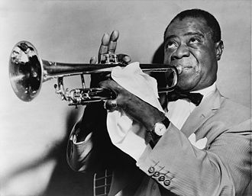
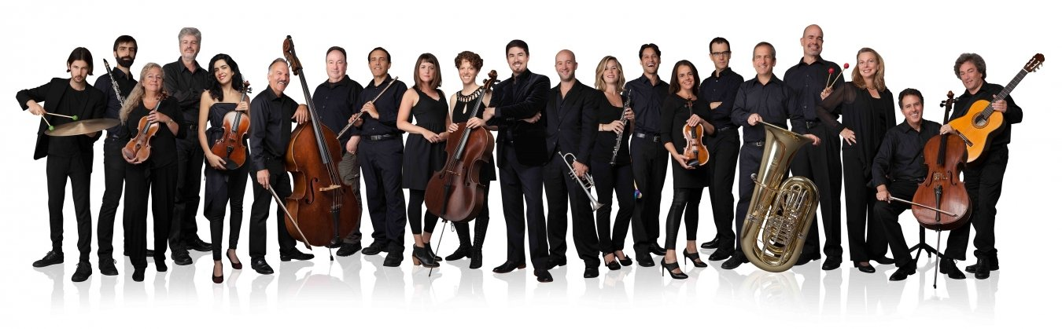
Different Idea 不同的想法
From solo
从独奏
to ensemble
到合奏

Slide 13
Ensemble Learning 合奏学习
Learn Several Classifiers
学习到多个分类器
  Rather than a single one 而不是一个
  Classification through voting
  用投票的方式分类
Expectation 预期
  For a single sample 针对单个数据
    More classifiers vote for the right answer than those vote for the wrong one
    相对于给出错误答案的分类器，更多的分类器给出了正确的答案

Slide 14


Illustrative Example: Weather Forecast 说明用例：天气预报
Truth 真相
1
2
3
4
5
Ensemble 合奏
X
X
X
X
X
X
X
X
X
X
X
X
X

Slide 15

What Does That Remind You?
这让你想起了什么？
Cheating in exams by checking answers w/ the others?
考试的时候作弊，和人对答案？

Slide 16
Illustrative Example 说明用例
  Attribute 2 属性2
Mix the 3 lines together in voting
把三条直线放在一起投票
  Attribute 1
  属性1
  Training data 训练数据

Slide 17
Illustrative Example 说明用例
  Attribute 2 属性2
Together how do they perform?
合在一起之后，它们表现如何？
  Attribute 1
  属性1
  Training data 训练数据
  Unseen data
  未知数据

Slide 18
Illustrative Example 说明用例
  Attribute 2 属性2
2 lines vote for red
2条直线投票为红色
  Attribute 1
  属性1
  Training data 训练数据
  Unseen data
  未知数据

Slide 19
Illustrative Example 说明用例
  Attribute 2 属性2
  Attribute 1
  属性1
  Training data 训练数据
2 lines vote for red
2条直线投票为红色
  Unseen data
  未知数据

Slide 20
Illustrative Example 说明用例
  Attribute 2 属性2
  Attribute 1
  属性1
  Training data 训练数据
2 lines vote for green
2条直线投票为绿色
  Unseen data
  未知数据

Slide 21
Illustrative Example 说明用例
  Attribute 2 属性2
2 lines vote for green
2条直线投票为绿色
  Attribute 1
  属性1
  Training data 训练数据
  Unseen data
  未知数据

Slide 22
In the Example 这个例子里
Suppose We Have 假定我们有
  3 learning algorithm instances
  三个学习算法的实例
    1 instance is lucky & 2 are not
    一个运气好，两个运气差
    But we do not know which one is lucky
    但我们不知道那个运气好
Combining the 3 把这三个合在一起
  We wash out the unluckiness
  我们把坏运气清除了

Slide 23
The Next Question
接下来的问题
How to Create Different Learning Algorithm Instances
如何构建出不同的学习算法实例
  Learning different classifiers
  学习到不同的分类器
    Compensating each other 相互补偿
Here We Learn a Simple Method
这里我们学习一个简单的方法
  For the problem of word sense disambiguation 用在词义消歧上

Slide 24
Different Context Size
不同的上下文大小
… to indicate declining interest rates because they permit portfolio managers …
… to indicate declining interest rates because they permit portfolio managers …
Short context, e.g., $±1$ window context emphasizes close colocation
短上下文，例如$±1$窗口强调邻近搭配

Slide 25
Different Context Size
不同的上下文大小
… to indicate declining interest rates because they permit portfolio managers …
… to indicate declining interest rates because they permit portfolio managers …
Long context, e.g., full context contains long-distance dependencies
长上下文，例如完整的上下文，包含了长距离依存关系

Slide 26
Different Context Size
不同的上下文大小
Take different context size 选取不同的上下文大小
… to indicate declining interest rates because they permit portfolio managers …
… to indicate declining interest rates because they permit portfolio managers …
…
Learn different classifiers w/ data of different context sizes, & then let them vote together
从不同的上下文大小的数据中学习到不同的分类器，让它们一起投票

Slide 27

Practice 9.1 实践9.1
Practice time: try perceptron ensemble on word sense disambiguation
实践时刻：尝试用感知器合奏进行词义消歧
If you have time, also try the ensemble of logistic regression
如果你有时间，再试一下对数几率回归合奏

Slide 28
Results 结果
Methods 方法 | Accuracy 准确率
Nearest neighbor 最近邻 | 69.3%
Perceptron 感知器 | 83.6%
Perceptron w/ margin 带间距的感知器 | 85.7%
Logistic regression 对数几率回归 | 85.0%
Perceptron ensemble 感知器合奏 | 88.8%
Logistic regression ensemble 对数几率回归合奏 | 89.5%

Slide 29
The End

